Slide 2
As seen on

Slide 3
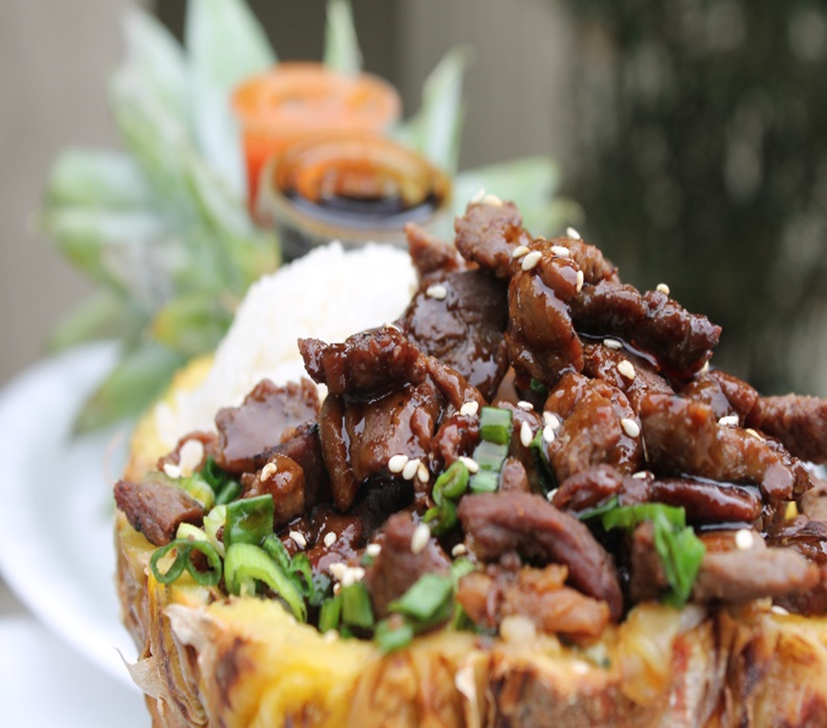
Mowie Wowie Pineapples
-Hawaiian Chicken.......$15.00
-Hawaiian Beef………..$15.00
-Hawaiian Sausage..…$15.00
-Hawaiian Shrimp…….$17.00
-Hawaiian Rib ..…….….$17.00
Baskets & Fries
-Fish & Chips…………….$13.00
-Shrimp & Chips………..$13.00
-Rib & Chips……………..$16.00
Kabob
-Shrimp & Pina………....$12.00
-Pineapple Kabob…….$6.00
Dinner
-Luau Rib Combo……....$16.00
Hawaiian Sweets
-Mixed Berries & Cream
Pineapple Bowl……….$12.00
-Pineapple & Coconut
Smoothies………...……$12.00
Drinks
-Bottled Soda…………….$3.00
-Bottled Water…………...$3.00
(plus tax)
@Ricardosfoodtruck

Slide 4
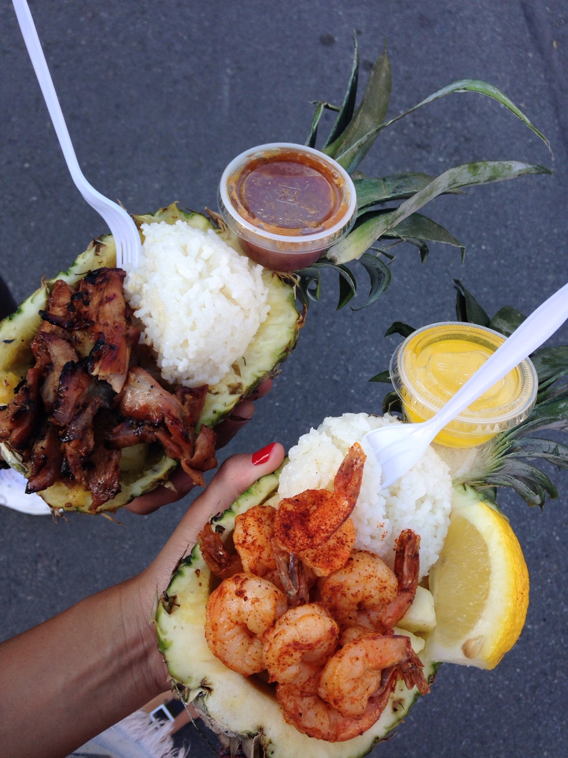
Mowie Wowie Pineapples
-Hawaiian Chicken.......$15.00
-Hawaiian Beef………..$15.00
-Hawaiian Sausage..…$15.00
-Hawaiian Shrimp…….$17.00
-Hawaiian Rib ..…….….$17.00
Baskets & Fries
-Fish & Chips…………….$13.00
-Shrimp & Chips………..$13.00
-Rib & Chips……………..$16.00
Kabob
-Shrimp & Pina………....$12.00
-Pineapple Kabob…….$6.00
Dinner
-Luau Rib Combo……....$16.00
Hawaiian Sweets
-Mixed Berries & Cream
Pineapple Bowl……….$12.00
-Pineapple & Coconut
Smoothies………...……$12.00
Drinks
-Bottled Soda…………….$3.00
-Bottled Water…………...$3.00
(plus tax)
@Ricardosfoodtruck

Slide 5
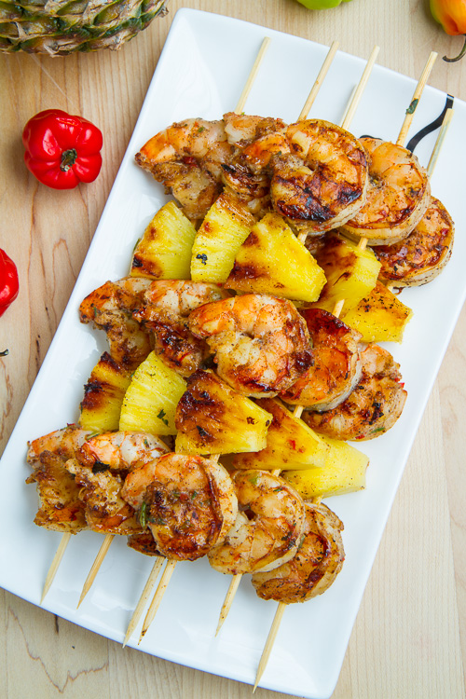
Mowie Wowie Pineapples
-Hawaiian Chicken.......$15.00
-Hawaiian Beef………..$15.00
-Hawaiian Sausage..…$15.00
-Hawaiian Shrimp…….$17.00
-Hawaiian Rib ..…….….$17.00
Baskets & Fries
-Fish & Chips…………….$13.00
-Shrimp & Chips………..$13.00
-Rib & Chips……………..$16.00
Kabob
-Shrimp & Pina………....$12.00
-Pineapple Kabob…….$6.00
Dinner
-Luau Rib Combo……....$16.00
Hawaiian Sweets
-Mixed Berries & Cream
Pineapple Bowl……….$12.00
-Pineapple & Coconut
Smoothies………...……$12.00
Drinks
-Bottled Soda…………….$3.00
-Bottled Water…………...$3.00
(plus tax)
@Ricardosfoodtruck

Slide 6
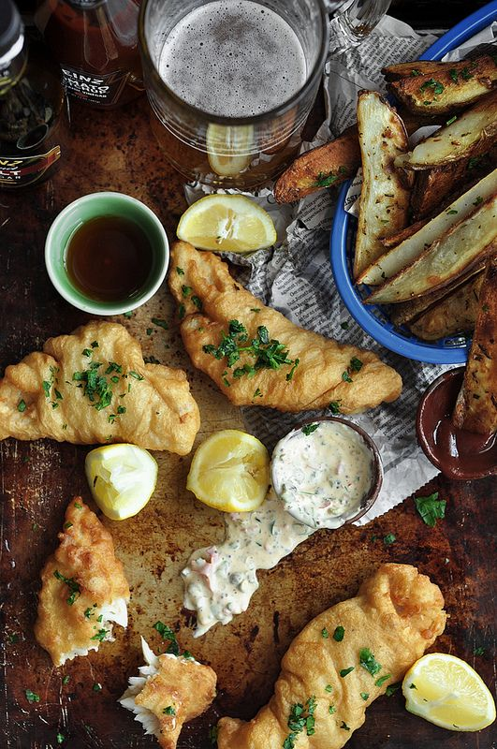
Mowie Wowie Pineapples
-Hawaiian Chicken.......$15.00
-Hawaiian Beef………..$15.00
-Hawaiian Sausage..…$15.00
-Hawaiian Shrimp…….$17.00
-Hawaiian Rib ..…….….$17.00
Baskets & Fries
-Fish & Chips…………….$13.00
-Shrimp & Chips………..$13.00
-Rib & Chips……………..$16.00
Kabob
-Shrimp & Pina………....$12.00
-Pineapple Kabob…….$6.00
Dinner
-Luau Rib Combo……....$16.00
Hawaiian Sweets
-Mixed Berries & Cream
Pineapple Bowl……….$12.00
-Pineapple & Coconut
Smoothies………...……$12.00
Drinks
-Bottled Soda…………….$3.00
-Bottled Water…………...$3.00
(plus tax)
@Ricardosfoodtruck

Slide 7
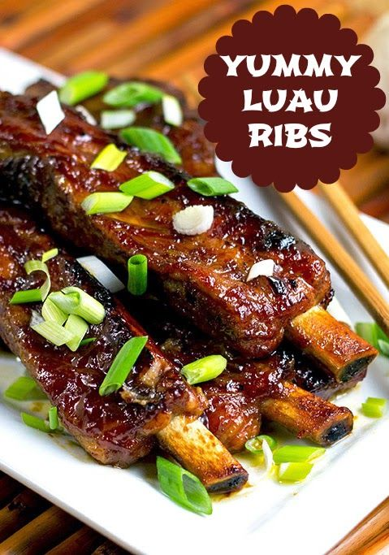
Mowie Wowie Pineapples
-Hawaiian Chicken.......$15.00
-Hawaiian Beef………..$15.00
-Hawaiian Sausage..…$15.00
-Hawaiian Shrimp…….$17.00
-Hawaiian Rib ..…….….$17.00
Baskets & Fries
-Fish & Chips…………….$13.00
-Shrimp & Chips………..$13.00
-Rib & Chips……………..$16.00
Kabob
-Shrimp & Pina………....$12.00
-Pineapple Kabob…….$6.00
Dinner
-Luau Rib Combo……....$16.00
Hawaiian Sweets
-Mixed Berries & Cream
Pineapple Bowl……….$12.00
-Pineapple & Coconut
Smoothies………...……$12.00
Drinks
-Bottled Soda…………….$3.00
-Bottled Water…………...$3.00
(plus tax)
@Ricardosfoodtruck

Slide 8
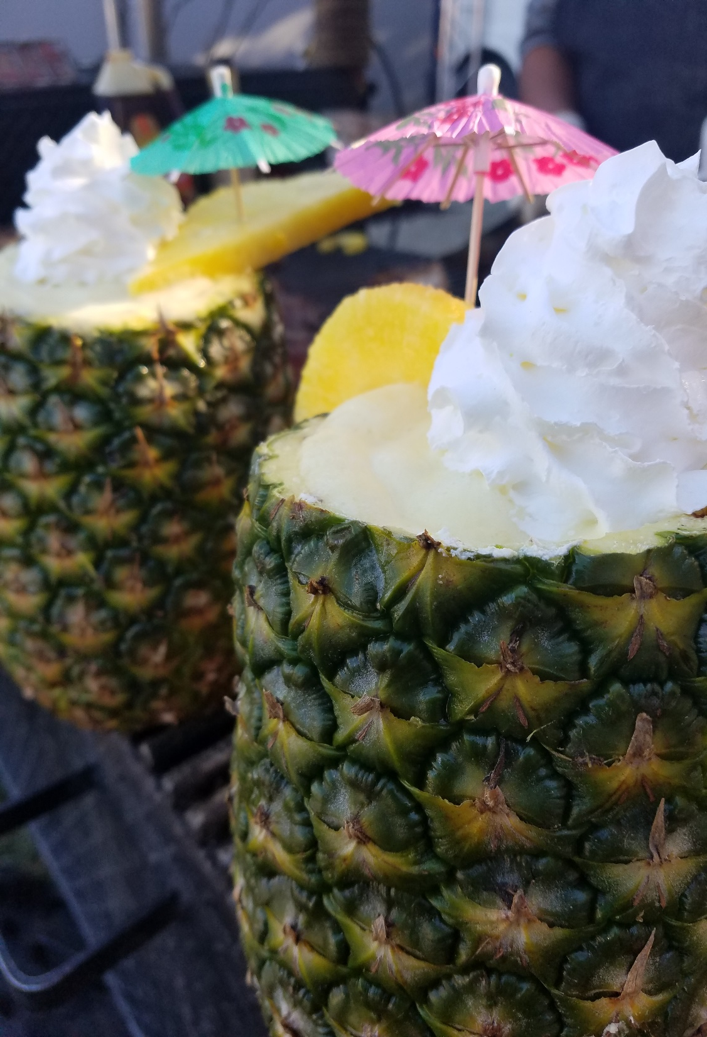
Mowie Wowie Pineapples
-Hawaiian Chicken.......$15.00
-Hawaiian Beef………..$15.00
-Hawaiian Sausage..…$15.00
-Hawaiian Shrimp…….$17.00
-Hawaiian Rib ..…….….$17.00
Baskets & Fries
-Fish & Chips…………….$13.00
-Shrimp & Chips………..$13.00
-Rib & Chips……………..$16.00
Kabob
-Shrimp & Pina………....$12.00
-Pineapple Kabob…….$6.00
Dinner
-Luau Rib Combo……....$16.00
Hawaiian Sweets
-Mixed Berries & Cream
Pineapple Bowl……….$12.00
-Pineapple & Coconut
Smoothies………...……$12.00
Drinks
-Bottled Soda…………….$3.00
-Bottled Water…………...$3.00
(plus tax)
@Ricardosfoodtruck

Slide 9
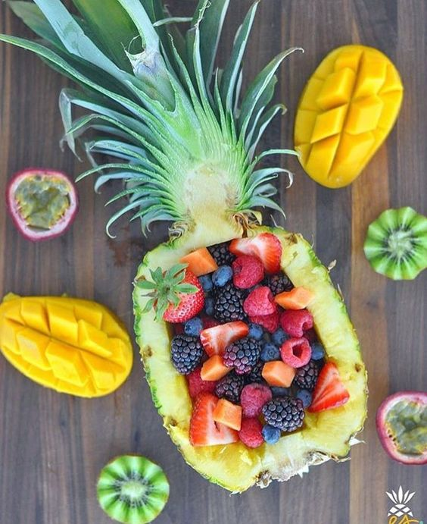
Mowie Wowie Pineapples
-Hawaiian Chicken.......$15.00
-Hawaiian Beef………..$15.00
-Hawaiian Sausage..…$15.00
-Hawaiian Shrimp…….$17.00
-Hawaiian Rib ..…….….$17.00
Baskets & Fries
-Fish & Chips…………….$13.00
-Shrimp & Chips………..$13.00
-Rib & Chips……………..$16.00
Kabob
-Shrimp & Pina………....$12.00
-Pineapple Kabob…….$6.00
Dinner
-Luau Rib Combo……....$16.00
Hawaiian Sweets
-Mixed Berries & Cream
Pineapple Bowl……….$12.00
-Pineapple & Coconut
Smoothies………...……$12.00
Drinks
-Bottled Soda…………….$3.00
-Bottled Water…………...$3.00
(plus tax)
@Ricardosfoodtruck

